Slide 1
ONLINE BLOCKCHAIN BASED CERTIFICATE GENERATION AND VALIDATION SYSTEM FOR GOVERNMENT ORGANIZATION
PIP2001 Capstone Project
Review-0
Batch Number:CSE-G199
Under the Supervision of,
Mr.Amarnath JL
Assistant Professor
School of Computer Science and Engineering
Presidency University
Roll Number | Student Name
20211CSE0628 | Prakruthi S
20211CSE0618 | Deepthi R
20211CSE0677 | Nidhisha N
Name of the Program: CSE
Name of the HoD: Dr.Asif Mohammed H.B
Name of the Program Project Coordinator: Mr. Amarnath J.L
Name of the School Project Coordinators: Dr. Abdul Khadar A

Slide 2
Content
Problem Statement
Github Link
Analysis of Problem Statement
Timeline of the Project
References

Slide 3
Problem Statement Number:
Organization: Government of Gujarat
Category (Hardware / Software / Both) : Software
Problem Description: The lack of a standardized system for verifying digital certificates leads to fraud, duplication, and manual verification inefficiencies for industries, institutions, and government offices. A Blockchain-Based Digital Certificate System ensures tamper-proof issuance, secure storage, and instant verification, enhancing trust and transparency across sectors.
Difficulty Level: Simple

Slide 4
Github Link
The Github link provided should have public access permission.
Github Link
https://github.com/Prakruthi27441/Project.git

Slide 5
Analysis of Problem Statement
Technology Stack Components:
Ethereum : As the local blockchain network Ethereum is a decentralized, open-source blockchain platform featuring smart contract functionality. It is the second-largest cryptocurrency by market capitalization, after Bitcoin.
Truffle: For smart contract development and deploymentTruffle is a development suite for Ethereum, simplifying smart contract development, testing, and deployment. It provides tools for compiling, linking, deploying, and managing smart contracts, making the development lifecycle more efficient.
Streamlit: For developing the web applicationIt allows developers to create interactive applications with minimal coding, directly from Python scripts.

Slide 6
Analysis of Problem Statement (contd...)
Technology Stack Components:
Pinata: As an IPFS clientAll User-Data is stored on IPFS also every data is first encryted locally and then send to ipfs to have more security
Identity: DID solutionfor representing users and institutions on the blockchain, enhancing privacy and interoperability.
Docker: To containerize the entire application into different services for infrastructure

Slide 7
Analysis of Problem Statement (contd...)
Software Requirements:
Testing Frameworks: Truffle and ganache-cli
Monitoring Tools: To track system performance and identify issues.
Blockchain: D-App on Ethereum. Metamask Browser Extension to work with Ethereum.
Database: PostgreSQL, MySQL or MongoDB.
Backend: Node.js (Express 21.0.0 or higher) , Python (3.9.10 or higher)

Slide 8
Analysis of Problem Statement (contd...)
Software Requirements:
Frontend: React js
Security: HSMs, access control lists
Identity: DID solutions
Infrastructure: Docker
Uploading certificates : IPFS (Pinata)
Web application : Streamlit

Slide 9
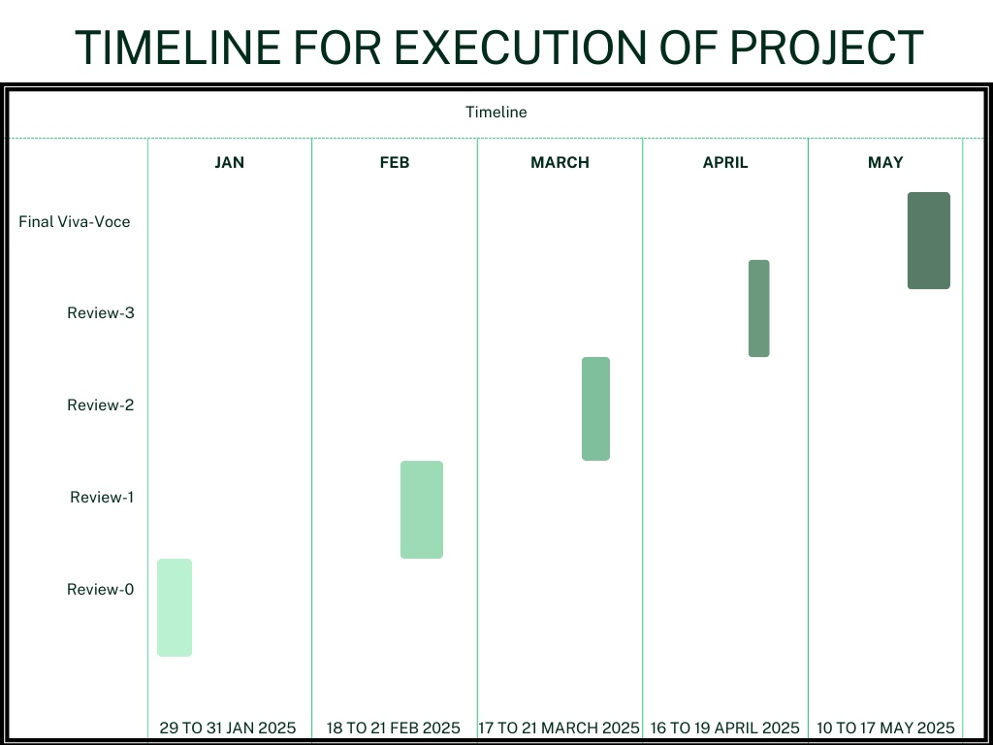
Timeline of the Project (Gantt Chart)

Slide 10
References (IEEE Paper format)
[1] Zheng, S. Xie, H. Dai, X. Chen and H. Wang, "An Overview of Blockchain Technology: Architecture Consensus
and Future Trends", 2017 IEEE International Congress on Big Data (BigData Congress), pp. 557-564, 2017.
[2] C. Ye, G. Li, H. Cai, Y. Gu and A. Fukuda, "Analysis of Security in Blockchain: Case Study in 51%-Attack
Detecting", 2018 5th International Conference on Dependable Systems and Their Applications (DSA), pp.
15-24, 2018.
[3] M. J. M. Chowdhury, A. Colman, M. A. Kabir, J. Han and P. Sarda, "Blockchain Versus Database: A Critical
Analysis", 2018 17th IEEE International Conference On Trust Security And Privacy In Computing And
Communications/12th IEEE International Conference On Big Data Science And Engineering.
[4] A. A. Monrat, O. Schelén and K. Andersson, "A Survey of Blockchain From the Perspectives of Applications
Challenges and Opportunities", IEEE Access, vol. 7, pp. 117134-117151, 2019.
[5] Benyuan He, “An Empirical Study of Online Shopping Using Blockchain T echnology”, Department of
Distribution Management, Takming University of Science and Technology, Taiwan, R.O.C., 2017.
[6] . P. Oganda, N. Lutfiani, Q. Aini, U. Rahardja, and A. Faturahman, ‘‘Blockchain education smart courses of
massive online open course using business model canvas,’’ in Proc. 2nd Int. Conf. Cybern. Intell. Syst. (ICORIS),
Oct. 2020, pp. 1–6, doi: 10.1109/ICORIS50180.2020.9320789.
[7] E. Kahraman. (Oct. 28, 2021). Wharton Accepts Crypto Payments for Blockchain Program Tuition Fees.
Accessed: Feb. 14, 2023. [Online]. Available: https://cointelegraph.com/news/wharton-accepts-crypto-
payments-for-blockchain-program-tuition-fees

Slide 11
References (IEEE Paper format) (contd...)
[8] P. Bhaskar, C. K. Tiwari, and A. Joshi, ‘‘Blockchain in education management: Present and
future applications,’’ Interact. Technol. Smart Educ., vol. 18, no. 1, pp. 1–17, May 2021, doi:
10.1108/ITSE-07-2020- 0102.
[9] H.A.Alsobhi,R.A.Alakhtar,A.Ubaid,O.K.Hussain,andF.K.Hussain, ‘‘Blockchain-based micro-
credentialing system in higher education insti- tutions: Systematic literature review,’’
Knowl.-Based Syst., vol. 265, Apr. 2023, Art. no. 110238, doi: 10.1016/j.knosys.2022.110238.
[10] D.-H. Nguyen, D.-N. Nguyen-Duc, N. Huynh-Tuong, and H.-A. Pham, ‘‘CVSS: A blockchainized
certificate verifying support system,’’ in Proc. 9th Int. Symp. Inf. Commun. Technol. (SoICT),
2018, pp. 436–442, doi: 10.1145/3287921.3287968.
[11] S.-K. Kim, ‘‘Blockchain smart contract to prevent forgery of degree certificates: Artificial
intelligence consensus algorithm,’’ Electronics, vol. 11, no. 14, p. 2112, Jul. 2022, doi:
10.3390/electronics11142112.
[12] A. Mohammad and S. Vargas, ‘‘Challenges of using blockchain in the education sector: A
literature review,’’ Appl. Sci., vol. 12, no. 13, p. 6380, Jun. 2022, doi: 10.3390/app12136380.
[13] M. Schulz and J. A. Hennis-Plasschaert, Regulation (Eu) 2016/679 Of The European
Parliament And Of The Council of 27, April 2016, Official Journal of the European Union,
[Online]. Available: http://data.europa.eu/eli/reg/2016/679/oj

Slide 12


